Slide 1


COMP507 IT Project Management Schedule Management
Daniel

Slide 2
Learning Objectives
Use Gantt chart concepts for planning and tracking the schedule of a project (executing, M/C) – So great for reporting.
Use milestones in projects (planning, m/C)
Find the critical path for a project, (planning, monitoring and controlling)
Explore the use of the Program Evaluation and Review Technique (PERT) to
schedule development (planning/ M/C)
Describe how project management software can assist in project time management

Slide 3
Purpose of the Schedule Management
The purpose of developing an SMP is to ensure schedule development follows a well thought-out process, with enough structure and an efficient approach to producing a reliable schedule.
Building a schedule by immediately entering activities into software without first designing the Schedule Management Plan (SMP) is like starting a project without thinking through the plan or schedule.
A properly developed schedule acts as a guideline and map for the project.
If you treat schedule development as a project itself, it has all project characteristics: temporary, start and end dates, specific goals, and multiple parties involved.
Since schedule development is effectively a project, it makes sense that it needs its own plan, this is the role of the SMP.
The schedule’s purpose must align with the execution strategy, such as protecting time-related costs, controlling the budget, managing change, supporting detailed management, controlling resources, coordinating owners/third parties, improving forecasting accuracy, and supporting claims avoidance/documentation.
The SMP helps keep the schedule’s purpose organized and focused.

Slide 4
Project Schedule Management Processes
Three key processes:
1. Planning schedule
  Defining activities (Based on WBS): identifying the specific activities that the project team members and stakeholders must perform to produce the project deliverables
  Estimating activity durations: estimating the time needed to complete individual activities
  Sequencing activities: identifying and documenting the relationships between activities
  Estimating activity resources: estimating how many resources a project team should use to
perform activities
  Developing the schedule: based on activities, their sequences, and estimated durations, including their resource estimates, create the project schedule.
2. Set the baseline to execute the schedule (google how to set the baseline)
3. Controlling the schedule: controlling and managing changes to the project schedule

Slide 5
Planning Schedule Management
To plan and work according to the schedule need a schedule management plan
A schedule management plan includes:
  Project schedule model development: (the WBS)
    project activities, estimates, dependencies, and other planning information
  The scheduling methodology
    Critical path, milestones
  Level of accuracy and units of measure
    How accurate are the estimates to be: hours, day, or another unit
  Control thresholds
    Variance threshold for monitoring schedule performance
  Rules of performance measurement
    Must set a baseline - to show work done every day/week/month - reporting.
    Critical path, milestones for monitoring and control
    Earned Value Management (EVM) can be used
  Reporting formats
    format and frequency of reports

Slide 6
Planning Schedule Management
To plan and work according to the schedule need a schedule management plan
A schedule management plan includes:
  Project schedule model development: (the WBS)
    project activities, estimates, dependencies, and other planning information
  The scheduling methodology
    Critical path, milestones
  Level of accuracy and units of measure
    How accurate are the estimates to be: hours, day, or another unit
  Control thresholds
    Variance threshold for monitoring schedule performance
  Rules of performance measurement
    Must set a baseline - to show work done every day/week/month - reporting.
    Critical path, milestones for monitoring and control
    Earned Value Management (EVM) can be used
  Reporting formats
    format and frequency of reports

Slide 7
Schedule as a Communication and Control Tool
Shows how and when project scope will be delivered
Manages stakeholder expectations about timing and progress
Provides a basis for performance reporting
Connects activities, durations, resources, dependencies and constraints
Supports forecasting and schedule change decisions
Turns the project plan into a time-based delivery map
PMBOK® Guide Sixth Edition – Chapter 6
Notes:
\

Slide 8
From Schedule Method to Schedule Model
Select a scheduling method: critical path, agile or hybrid
Add project data: activities, durations, resources and dependencies
Include constraints, assumptions, calendars and milestones
Use a scheduling tool to organise the schedule logic
Produce the project schedule for execution and control
Update the model as real performance information becomes available
PMBOK® Guide Sixth Edition – Chapter 6

Slide 9
Schedule Model, Project Schedule and Baseline
Schedule model: the logic of activities, durations and dependencies
Schedule data: supporting information used to describe and control the schedule
Project schedule: planned dates, milestones and time-based work view
Schedule baseline: approved schedule model used for comparison
Only approved changes should update the baseline
The baseline makes schedule performance measurable
PMBOK® Guide Sixth Edition – Chapter 6

Slide 10
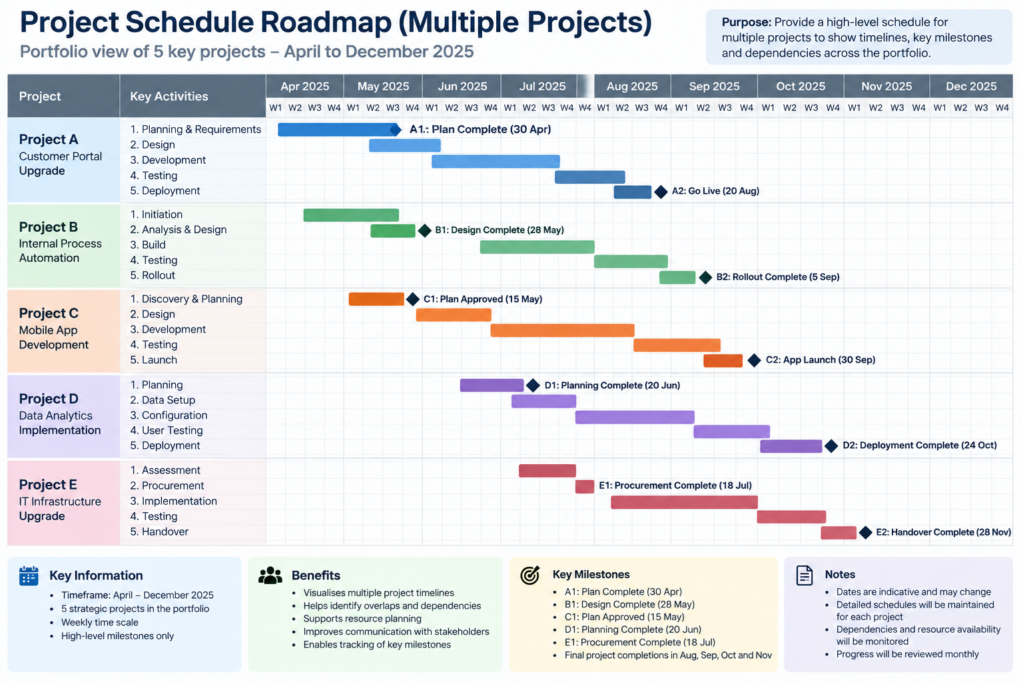
Schedule Roadmap Plan
PMBOK® Guide Sixth Edition – Chapter 6

Slide 11
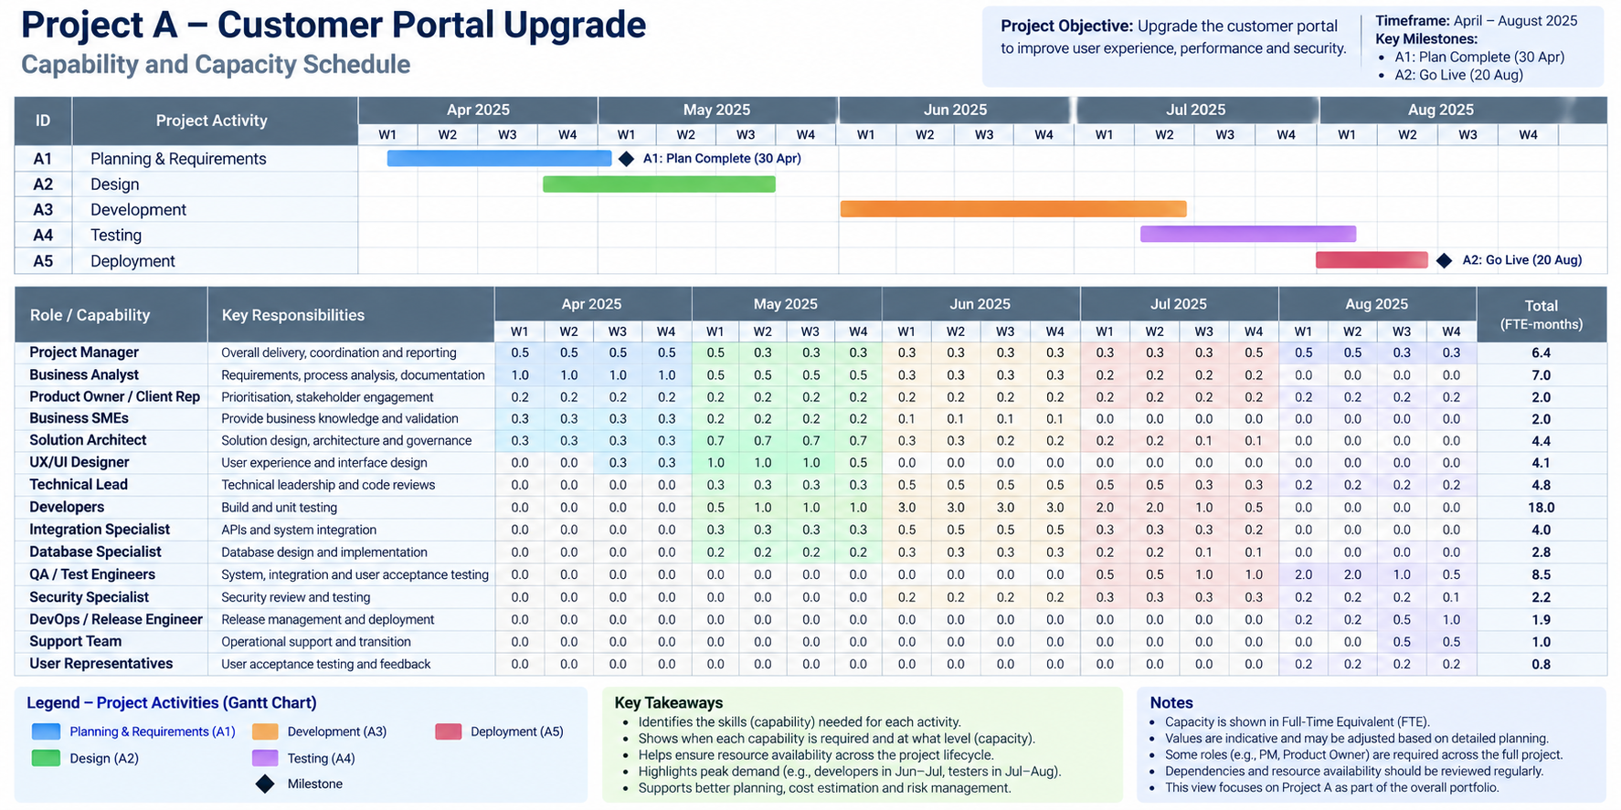
Portfolio/Program Roadmap Plan
PMBOK® Guide Sixth Edition – Chapter 6

Slide 12
Scheduling in Agile and Adaptive Projects
Use short cycles to plan, work, review and adapt
Refine backlog items just before delivery
Timeboxes create regular schedule checkpoints
On-demand / Kanban pulls work when capacity is available
Large initiatives may need hybrid roadmaps and agile delivery
The schedule welcomes change but still needs control
PMBOK® Guide Sixth Edition – Chapter 6

Slide 13
WBS- Defining Activities/Task
WBS provides a model to break the project work into phases and individual pieces of independent work known as activity or task
An activity or task, called a work package an expected duration, cost, and resource requirements
1. Planning phase (a phase in the project)
1.1 Project initiation (a main task but broken into sub-tasks. It is an independent task compared to a task at its level i.e., 1.2. the duration
1.1.1 stakeholder register (a sub-task or a work package, independent of the two sub-tasks and will have a duration, cost, and resource requirement)
1.1.2 project charter ((a sub-task or a work package that will have a duration, cost, and resource requirement)
1.1.3 Business case (a sub-task or a work package that will have a duration, cost, and resource requirement)
      1.2 Develop project plans
      1.2.1 stakeholder management strategy
      1.2.2 risk register
      1.2.3 issue register
      1.2.4 business cases
      The project initiation task, its duration will be the total time taken to do its three sub-tasks; the same applies to the cost and resources requirements
      For the phase- the total duration will be all the durations of its tasks added together. The same applies to the cost and resources

Slide 14
Activity/Task List and Attributes
Activities/tasks must have
  the activity name
  an activity identifier or number (MS Project assigns the number automatically)
  a brief description of the activity
Activity attributes provide more information such as predecessors, successors, logical relationships, leads and lags, resource requirements, constraints, imposed dates, and assumptions related to the activity
Vital in sequencing and re-sequencing your project
. Planning phase
1.1 Project initiation (activity number, activity name)
1.1.1 stakeholder register
1.1.2 project charter (1.1.2 done at the same time or after 1.1.1? if after than 1.1.1 is a predecessor task to task 1.1.2)
1.1.3 Business case (1.1.2 can be a predecessor to 1.1.3)

Slide 15
Milestones
A milestone is a significant event that normally has no duration
It often takes several activities and a lot of work to complete a milestone
Milestones are useful tools for setting schedule goals and monitoring progress
Example- you can set a milestone based on completing the project initiation tasks. You can have more than one milestone in a phase
1.1 Project initiation
1.1.1 stakeholder register
1.1.2 project charter
1.1.3 Business case
Milestone 1 initiation tasks completed
(Milestone date will be shown based on your tasks scheduled in MS Project)

Slide 16
Three types of Dependencies
Mandatory dependencies: inherent in the nature of the work being performed on a project, sometimes referred to as hard logic
Discretionary dependencies: defined by the project team. Sometimes referred to as soft logic and should be used with care since it may limit later scheduling options
External dependencies: involve relationships between project and non-project activities
Need to have a good understanding of WBS item characteristics

Slide 17
Network Diagrams
Network diagrams are the preferred technique for showing activity sequencing
A network diagram is a schematic display of the sequencing of activities/tasks in projects.
Two main formats are the Activity on Arrow (AoA) and Precedence DiagramMethod (PDM)

Slide 18
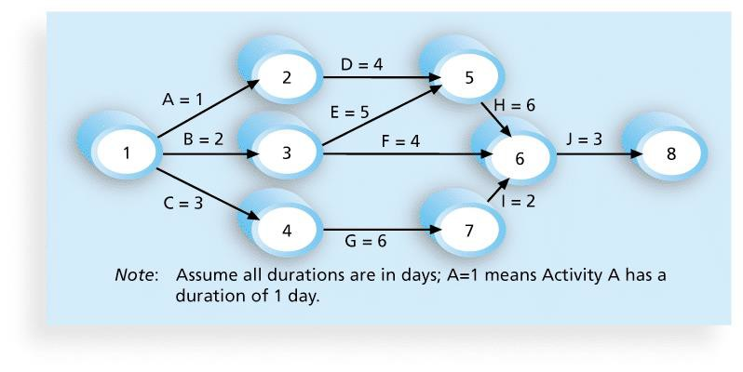
Figure 6-2. Network Diagram for Project X

Slide 19
Arrow Diagram Methods (ADM)
Also called Activity on Arrow (AOA) network diagrams
Activities are represented by arrows
Nodes are the starting and ending points of activities
Can only show finish-to-start dependencies

Slide 20
Process for Creating AOA Diagrams
Draw node 1. Find all of the activities that start at node 1. Draw their finish nodes and draw arrows between node 1 and those finish nodes. Put the activity letter or name and duration estimate on the associated arrow (not the node)
Continuing drawing the network diagram, working from left to right. Look for bursts and merges. Bursts occur when a single node is followed by two or more activities. A merge occurs when two or more nodes precede a single node
Continue drawing the network diagram until all activities are included on the diagram that have dependencies
As a rule of thumb, all arrowheads should flow toward the right, and no arrows should cross over on an AoA network diagram

Slide 21
Precedence Diagram Method (PDM)
In precedence diagram activities are represented in boxes
Arrows show the relationships between activities
Typically more popular than arrow diagram methods (ADM) and used in project management software
Precedence diagram is considered to be better at showing different types of dependencies

Slide 22
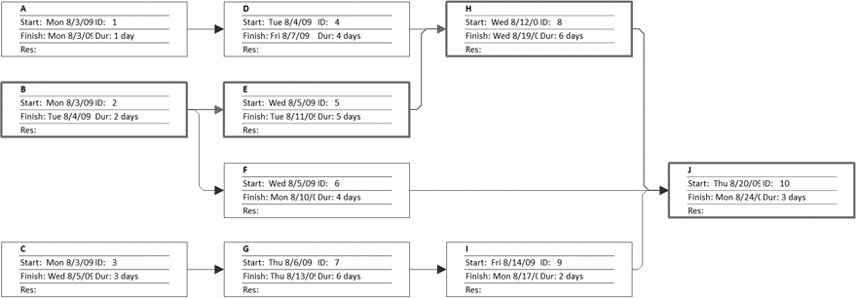
Figure 6-4. Sample PDM Network Diagram

Slide 23
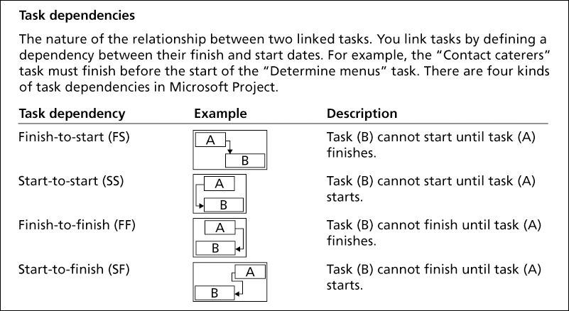
Figure 6-3. Task Dependency Types

Slide 24
Three-Point Estimates
Instead of providing activity estimates as a discrete number, such as
four weeks, it’s often helpful to create a three-point estimate
  an estimate that includes optimistic (shortest), most likely, and pessimistic (longest) estimates, such as three weeks for the optimistic, four weeks for the most likely, and five weeks for the pessimistic estimate - a range in effect
Three-point estimates are needed for Program Evaluation and Review Technique (PERT)
PERT is used to estimate project duration when there is a high degree of uncertainty about the individual activity duration estimates

Slide 25
PERT Formula and Example
PERT weighted average =
optimistic time + 4X most likely time + pessimistic time
6
Example:
PERT weighted average =
8 workdays + 4 X 10 workdays + 24 workdays
6
where optimistic time= 8 days most likely time = 10 days, and pessimistic time = 24 days
= 12 days
Therefore, you’d use 12 days on the network diagram instead of 10 when using PERT for the above example

Slide 26
Developing the schedule itself
The ultimate goal is to create a realistic project schedule that provides a basis for monitoring project progress for the time dimension of the project
Important tools and techniques include Gantt charts, critical path analysis, and Program Evaluation and Review Technique (PERT) analysis

Slide 27
Gantt Charts
Gantt charts provide a standard format for displaying project schedule information by listing project activities and their corresponding start and finish dates in a calendar format
Common symbols include:
  A black diamond: a milestones
  Thick black bars: summary tasks
  Lighter horizontal bars (often in blue): durations of tasks
  Arrows: dependencies between tasks

Slide 28
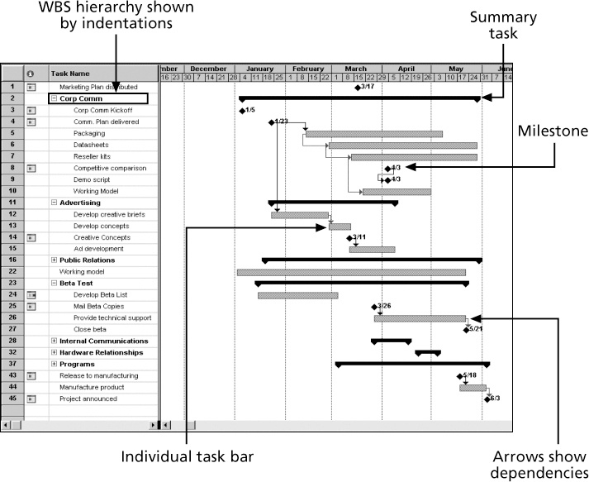
Figure 6-6. Gantt Chart for Software Launch Project

Slide 29
Adding Milestones to Gantt Charts
Many people like to focus on meeting milestones, especially for large projects (often these are Key Performance Indicators)
Milestones emphasize important events or accomplishments on projects
Normally you create a milestone by entering tasks with a zero duration, or you can mark any task as a milestone in the menu

Slide 30
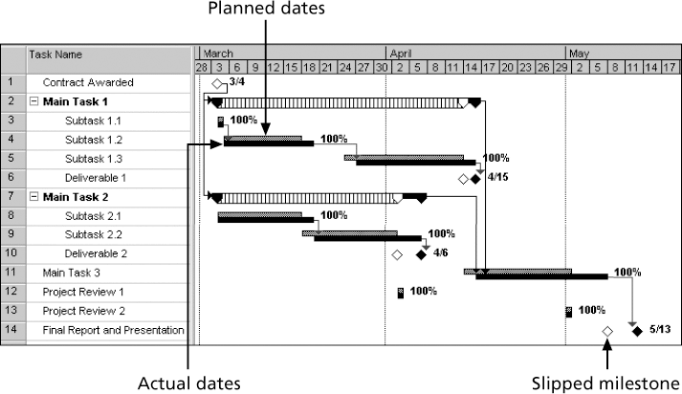
Figure 6-7. Sample Tracking Gantt Chart

Slide 31
Critical Path Method (CPM)
CPM is a network diagram technique used to predict total project duration
A critical path for a project is the series of activities that determines the earliest time by which the project can be completed
The critical path is the longest path through the network diagram and has the
least amount of slack or float
Slack or float is the amount of time an activity may be delayed without delaying a succeeding activity or the project finish date
Activities that fall on the critical path must be started on time and finished on time, otherwise it will delay other tasks and the overall completion of the project.

Slide 32
Calculating the Critical Path
First develop an effective network diagram
Add the duration estimates for all activities on each path through the network diagram
The longest path from beginning to end is the critical path
If one or more of the activities on the critical path takes longer than planned, the whole project schedule will slip unless corrective actions are taken
Sometimes that could mean staff working overtime, adding more staff to a project, outsourcing aspects rather than in-house, pulling resources from other projects (potentially delaying them)
Pulling back on quality or on scope

Slide 33
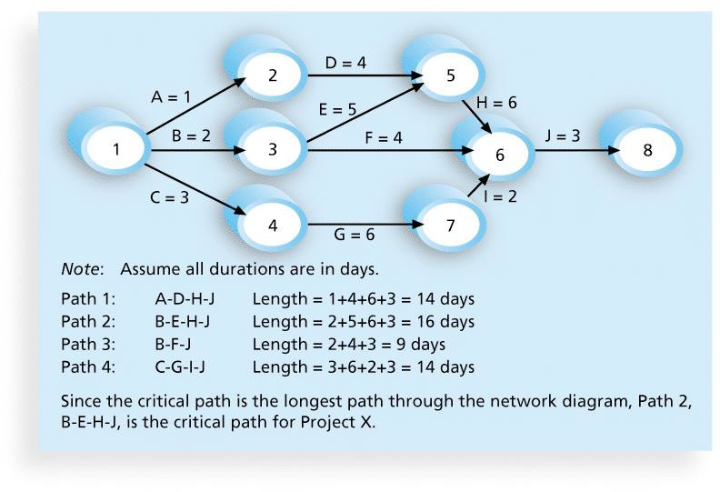




Figure 6-8. Determining the Critical Path for Project X

Slide 34
More on the Critical Path
The critical path is not the one with all the critical activities; it only accounts for time
There can be more than one critical path if the lengths of two or more paths are the same
The critical path can change several times as the project progresses

Slide 35
Using Critical Path Analysis to Make Schedule Trade-offs
Free slack or free float is the amount of time an activity can be delayed without delaying the early or on-time start of any immediately following activities
Total slack or total float is the amount of time an activity may be delayed from its early or on-time start without delaying the planned project finish date
A forward pass through the network diagram determines the early start and finish dates
A backward pass determines the late start and finish dates

Slide 36
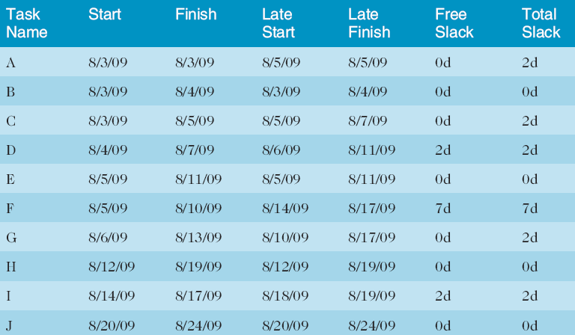
Table 6-1. Free and Total Float or Slack for Project X

Slide 37
Controlling the Schedule
Tools and techniques include
  Critical path, Milestone reports
  Progress reports
  A schedule change control system
  Project management software, including schedule comparison charts like
the tracking Gantt chart
  Variance analysis, such as analysing float or slack
  Performance management, such as Earned Value Analysis (EVA)

Slide 38
Schedule Compression: Crashing vs Fast Tracking
Schedule compression shortens duration without reducing project scope
Crashing: add resources to shorten critical path activities
Crashing may increase cost and risk
Fast tracking: overlap activities normally done in sequence
Fast tracking may increase rework and coordination risk
Use only where it can shorten critical path work
PMBOK® Guide Sixth Edition – Chapter 6

Slide 39
Managing Schedule Change
Compare actual progress against the schedule baseline
Analyse variance on critical and near-critical paths
Use what-if analysis, leads/lags, resource optimisation or compression
Forecast the effect on future dates
Raise a change request when the baseline or plan must change
Update schedule documents and stakeholders after approval
PMBOK® Guide Sixth Edition – Chapter 6

Slide 40
Checklist for the Schedule Management Plan
Checklist for the Schedule Management Plan (developed by Chris Carson and Patrick M. Kelly)
1. Development of Controllable Project Scope Definition
2. Project Implementation Basis
3. Contract
4. Notice to Proceed or Release Letter
5. Project Drawings
6. Area Designation Plan
7. Sequencing plan
8. Specifications
9. Scheduling Specification
10. Scope of Work Definition
11. Liquidated Damages or Incentive Schedule
12. Owner-Provided Items & Scope
13. Owner Milestones, Phases, or Master Schedules
14. Estimate & Quantity Surveys/Bills of Materials
15. Any Existing Internal WBS
16. Owner Separate Contracts and Scope (coordination between this and other external projects)
17. Value Analysis and Engineering
18. Project Historical Information

Slide 41
Summary
Project schedule management is often cited as the main source of conflict on projects, and most IT projects exceed initial time estimates
Main processes include
  Plan schedule management
  Define activities
  Sequence activities
  Estimate activity resources
  Estimate activity durations
  Develop the schedule
  Control the schedule

Slide 42
Homework
Before next week’s class Chapter 10 from Information Technology Project Management (2019) by Kathy Schwalbe
Start your Assignment 1 Part 2 and submit your Part 1 on Canvas

